Slide 1



A Federated Digital Twin Framework with Multimodal Data Integration for Personalized Healthcare Monitoring
Thesis Defense
Fall 2025
Department of Computer Science and Engineering
Green University of Bangladesh
Group Members
Sourav Debnath (221902246)
Nur Hasan Hasib (221902247)
Sheak Fahad (221902274)
Supervisor
Md. Jahidul Islam
Assistant Professor, Department of CSE, GUB
Co-supervisor
Ms. Shamima Islam
Assistant Professor, Department of CSE, GUB
30 January 2026

Slide 2


Table of Contents
02
04
01
Literature Review
03
Results & Discussion
05
Related Studies
Research Gap
Key Finding
Comparison
Performance Analysis
Introduction
Methodology
Conclusion
Background
Problem Statement
Motivation
Objectives
Approach
Research Design
Data Collection Methods
Data Analysis Methods
Summary of Key Findings
Contributions
Limitations
Future Works
References
Question & Answer Session

Slide 3



Thesis Introduction
2

Slide 4
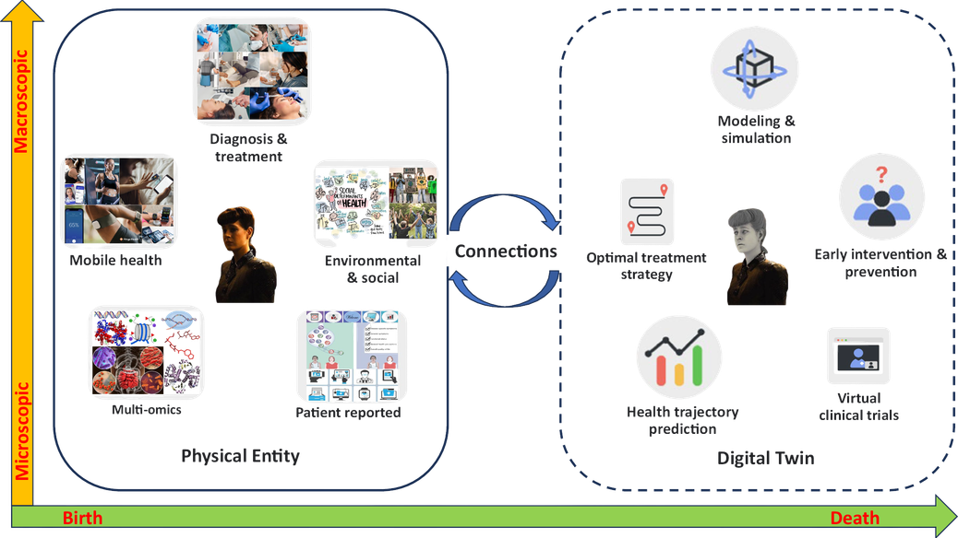
Introduction
Digital healthcare focuses on continuous monitoring of patient health conditions.Traditional systems rely on centralized data collection, which raises privacy and scalability concerns.
With the increasing use of wearable devices and IoT sensors, healthcare systems must ensure:
Secure data handling
Matching
Real-time health analysis
Fig 1:Digital twins for health
3
Introduction

Slide 5
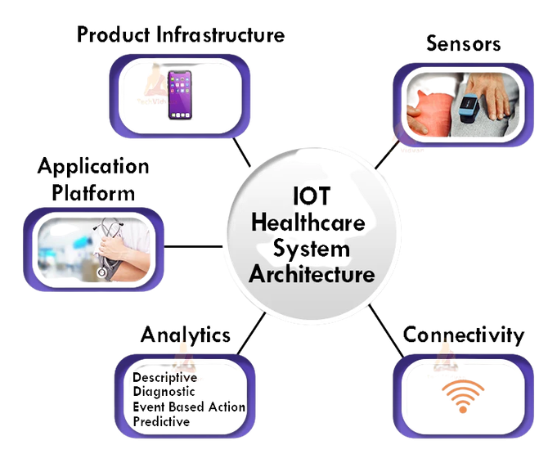
Background
IoT devices and wearable sensors generate large volumes of healthcare data.
Centralized systems face privacy, security, and regulatory limitations.
Federated learning supports decentralized and secure data utilization.
Fig 2 : IOT Healthcare System
4
Introduction

Slide 6
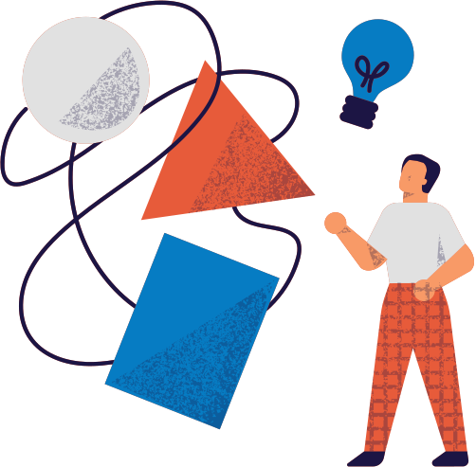
Problem Statement
Lack of patient-level personalization
Fragmented multimodal healthcare data
Privacy risks in centralized learning
Limited scalability of existing systems
5
Introduction

Slide 7
Motivation And Objectives
Motivation
Objectives
✓ To design a federated digital twin framework
for healthcare
✓ To integrate multimodal vital sign data
✓ To preserve privacy using federated learning
✓ To enable real-time health risk prediction
✓ To validate system performance
experimentally
✓ Need for continuous healthcare monitoring
✓ Increasing privacy regulations
✓ Demand for secure data sharing
✓ Need for scalable healthcare intelligence
6
Introduction

Slide 8

Literature Review
7

Slide 9
Literature Review
Existing studies show that digital twin technology is effective for personalized healthcare monitoring.
Federated learning and multimodal data analysis are also widely used to improve prediction accuracy while preserving data privacy.
Key Points:
Digital twins enable patient-centric health modeling
Federated learning supports secure, privacy-preserving analytics
8
Literature Review

Slide 10
Related Studies (1/3)
A Revolution of Personalized Healthcare: Enabling Human Digital Twin With Mobile AIGC[1]
Contributions
Limitations
Introduced a holistic architecture for mobile AIGC-powered digital twins in healthcare
Outlined lifecycle stages: data collection, management, training, and inference
Explored real-world use cases, including virtual physical therapy
Provided insights and open questions to inspire future research
Data Silos: Fragmented medical data limits collaboration; secure sharing is needed.
Cross-Modal Complexity: Difficult to align text, images, and signals effectively.
Model Efficiency: Large models increase energy and bandwidth costs; lightweight solutions are essential.
9
Literature Review

Slide 11
Related Studies (2/3)
Digital Twins for Cyber-Physical Healthcare Systems.[2]
Contributions
Limitations
Lack of real-time data processing in clinical settings
Weak interoperability across healthcare systems
Challenges in maintaining data privacy and quality
Limited personalization in treatment modeling
High computational cost for dynamic digital twins
Introduced core concepts of Digital Twins in healthcare
Proposed reference architecture for cyber-physical healthcare systems
Explored DT applications in precision medicine and patient modeling
Reviewed current trends and challenges in healthcare DT research
10
Literature Review

Slide 12
Related Studies (3/3)
A digital twin framework for real‑time healthcare monitoring: leveraging AI and secure systems for enhanced patient outcomes[3]
Contributions
Limitations
Real-time monitoring using AI and sensor data
MXBoost model for accurate health predictions
MDT framework with cloud, IoT, and security layers
Autocorrelation analysis for long-term trends
Rolling average smoothing for stable forecasts
No federated learning; only central training.
Personalization limited to body data.
Requires internet; not for offline or rural areas.
Uses basic RSA encryption; no advanced privacy.
Tested on small group (20 people) and one dataset.
11
Literature Review

Slide 13
Research Gap
Existing digital twin models are mostly centralized and generic.
Multimodal healthcare data are not effectively fused in current systems.
Privacy-preserving learning is applied without personalization.
A complete federated digital twin framework for real-time healthcare monitoring is still missing.
12
Literature Review

Slide 14
Methodology
13

Slide 15
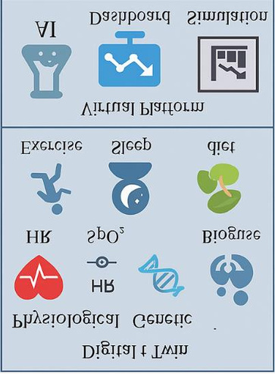
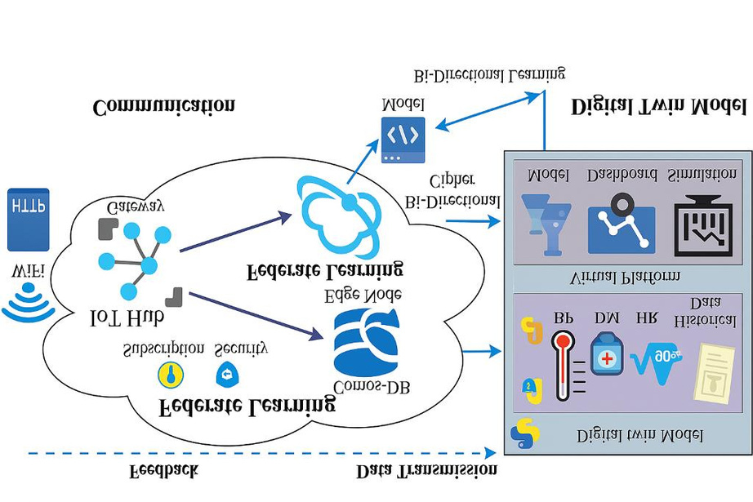
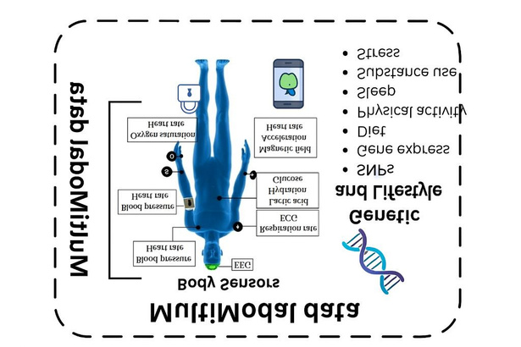


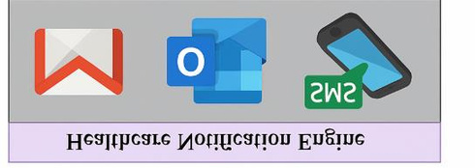
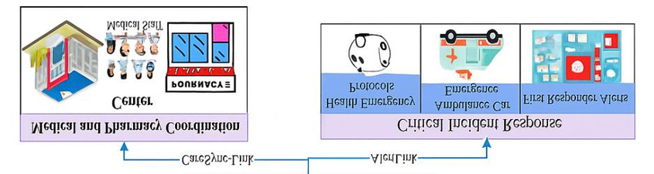






Methodology
Dual-Functional Data
Transmission Line
Mobile to engine interface
Real Time
Real Time Monitoring
Fig 3 : Proposed architecture of the federated digital twin framework
14
Methodology

Slide 16
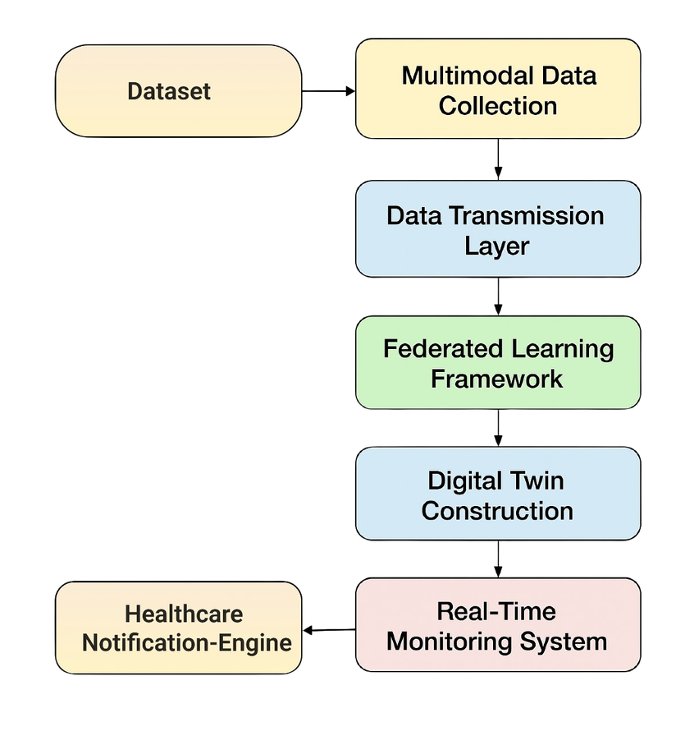
Approach
Local data are processed at edge devices to build patient digital twins.
Federated learning aggregates model parameters without sharing raw data.
The global model updates personalized digital twins continuously.
Fig 4 : Data Flow Diagram
15
Methodology

Slide 17
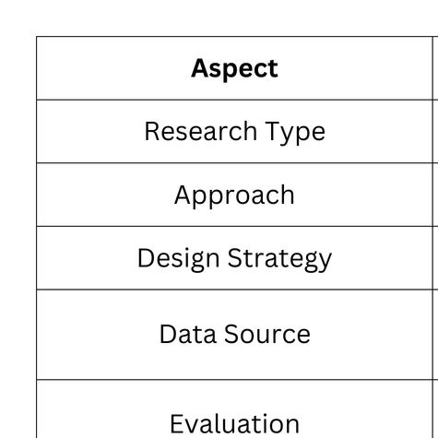
Research Design
This study follows a quantitative and experimental research design.
The design is suitable for evaluating prediction accuracy and system performance.
Table 3.1: Summary of Research Design
16
Methodology

Slide 18
Data Collection Methods
Data Collection
Dataset Description
Dataset Source: Kaggle – Human Vital Signs Dataset
Data Type: Heart rate, body temperature, oxygen saturation, and related vital indicators
Collection Method: Primary dataset
Sample Size: Multiple patient records representing realistic healthcare scenarios
The Human Vital Signs Dataset contains real-world physiological health indicators collected from multiple individuals.It supports health risk classification and prediction tasks. The dataset is suitable for evaluating personalized healthcare monitoring models.
17
Methodology

Slide 19
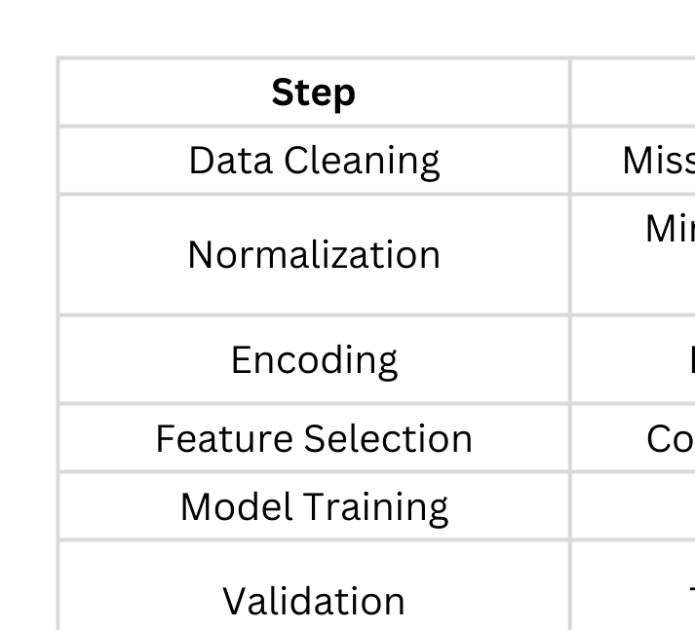
Data Analysis Methods
Table 3.2: Data Analysis Methods
18
Methodology

Slide 20
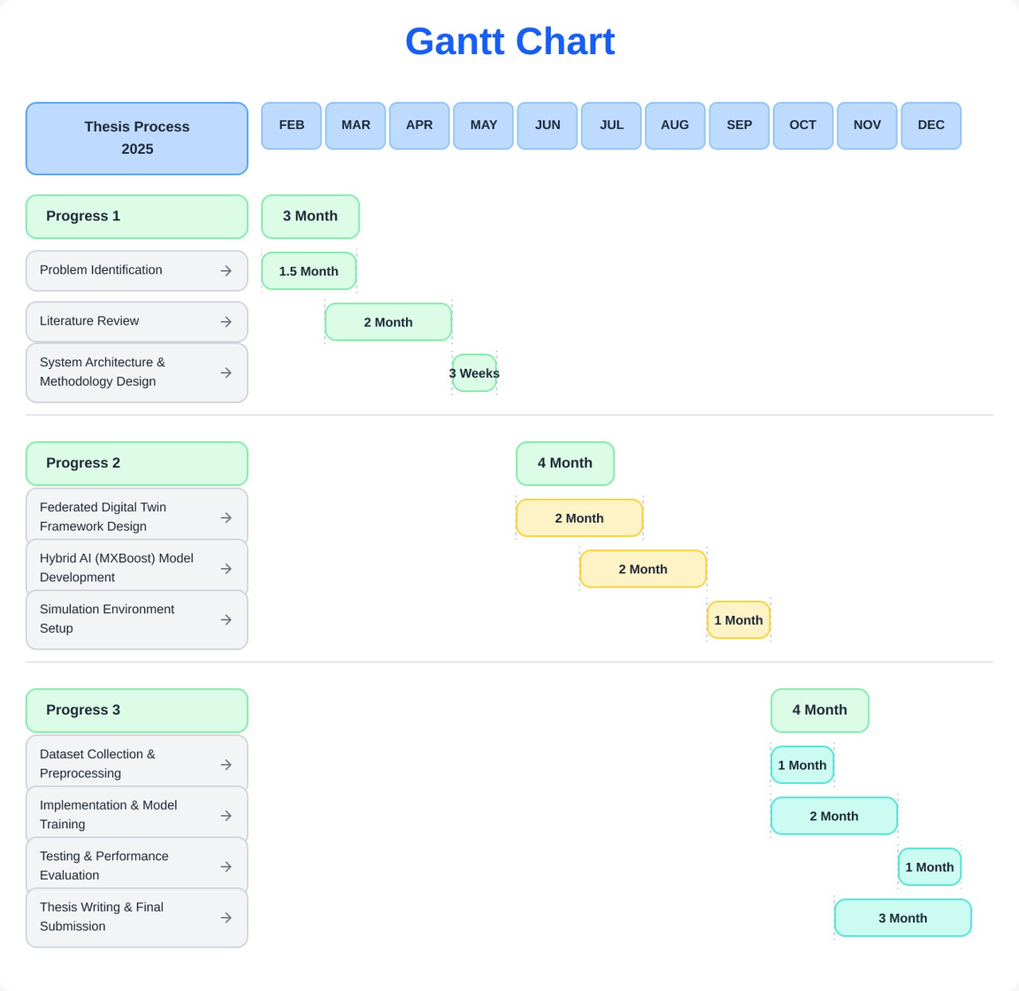
Gantt Chart
Fig 4 : Gantt Chart
19
Methodology

Slide 21
Implementation
Patient Data
↓
Preprocessing & Scaling
↓
Split into K Clients
↓
┌──────── Client 1 (MLP) ────────┐
│ │
├──────── Client 2 (MLP) ────────┤
│ │
└──────── Client K (MLP) ────────┘
↓
Global Digital Twin Prediction
↓
MXBoost Ensemble (MLP + XGBoost)
↓
Final Healthcare Decision
→ FedAvg → Global MLP
Fig 5 : Implementation work flow diagram
20
Methodology

Slide 22

Results And Discussion
21

Slide 23
Results & Discussion
This section presents the experimental results and discussion of the proposed federated digital twin healthcare framework.
The system was evaluated using real patient vital sign data under a simulated federated learning environment.
Key findings, comparisons, and performance analyses are discussed using visual results.
22
Results And Discussion

Slide 24
Key Finding
✓ Experiments were conducted in a simulated federated learning environment.
✓ Multimodal vital sign data improved prediction accuracy.
✓ Hybrid AI model (MXBoost) achieved the best performance.
✓ The system successfully detects abnormal health conditions.
23
Results And Discussion

Slide 25
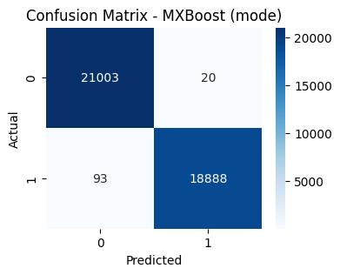
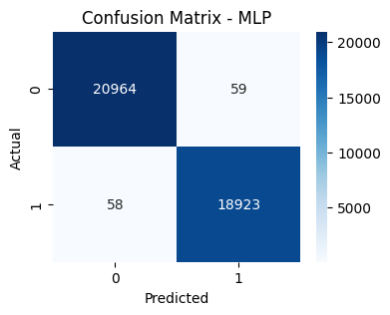

Confusion Matrix
Fig 8: MXBoost: [[ 21003 , 20 ], [93 ,18888]]
Fig 6: MLP: [[20964, 59], [58 , 18923]]
Fig 7: XGBoost: [20971 , 52], [ 56 , 18925]]
24
Results And Discussion

Slide 26
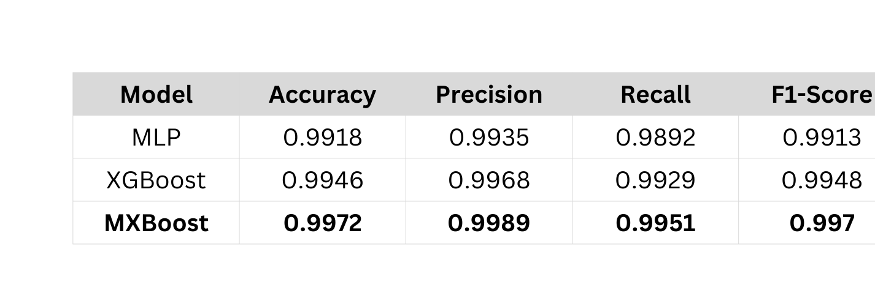
Overall performance
Table 4.1 indicates that all models achieved accuracy above 99%. MXBoost shows the best overall performance with the highest accuracy, F1-score, and AUC. XGBoost and MLP also provide consistent and reliable prediction results.
25
Results And Discussion

Slide 27
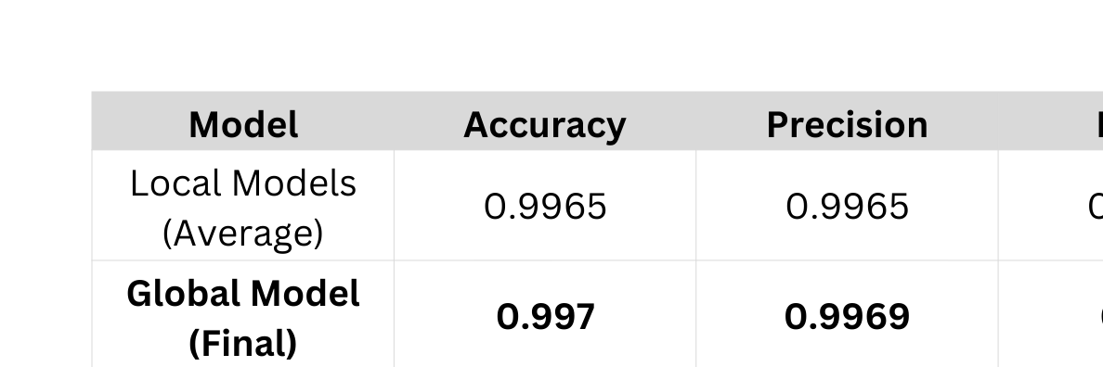
Federated learning and model aggregations.
Table 4.2 presents the average local models and the global final updates with the 10
round of epoch and update the global models through the local one. This ensure the federated learning and model aggregations.
26
Results And Discussion

Slide 28
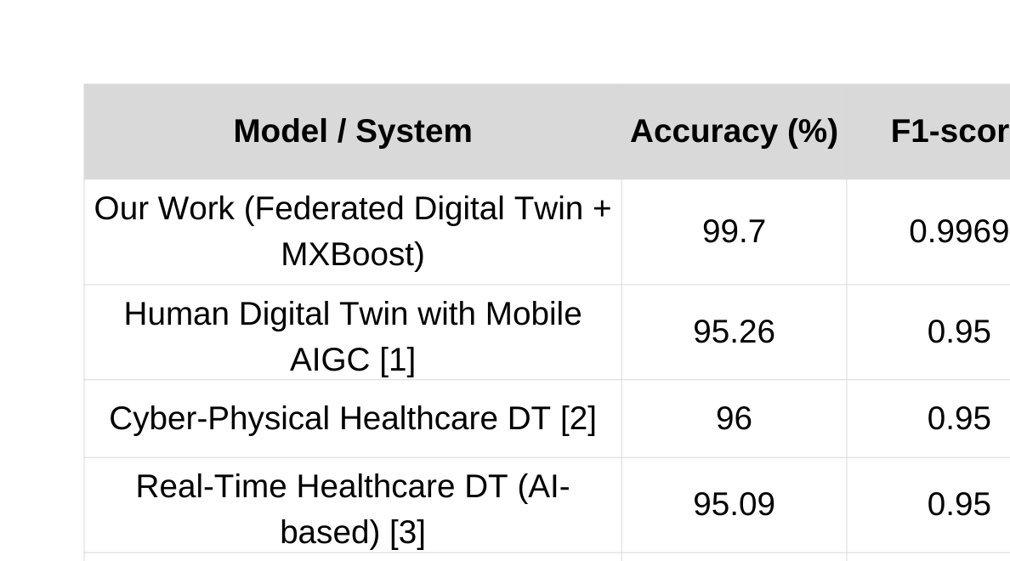
Comparison
Table 4.3: Performance Comparison with Existing Systems
27
Results And Discussionl

Slide 29
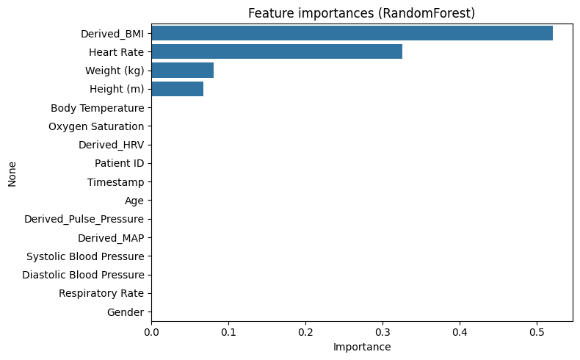
Performance Analysis
Fig 9: Horizontal bar chart of feature importance from Random Forest
28
Results And Discussion

Slide 30
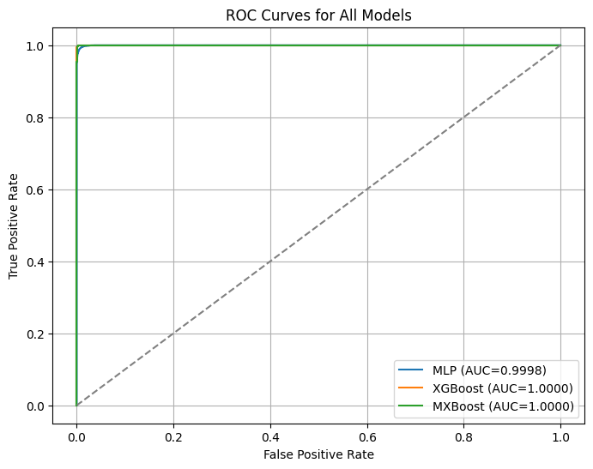
Performance Analysis
Performance was evaluated using accuracy, precision, recall, and F1-score.
The hybrid MXBoost model consistently outperformed baseline models.
The results indicate reliable and stable healthcare risk prediction.
Fig 10: ROC Curves
29
Results And Discussion

Slide 31
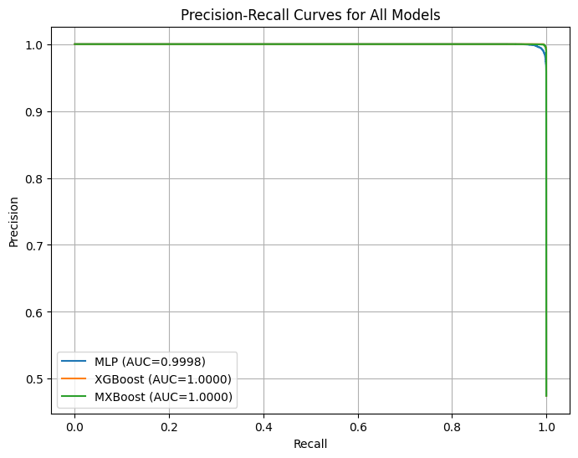
Performance Analysis
Fig 11: Precision-Recall Curve
30
Results And Discussion

Slide 32
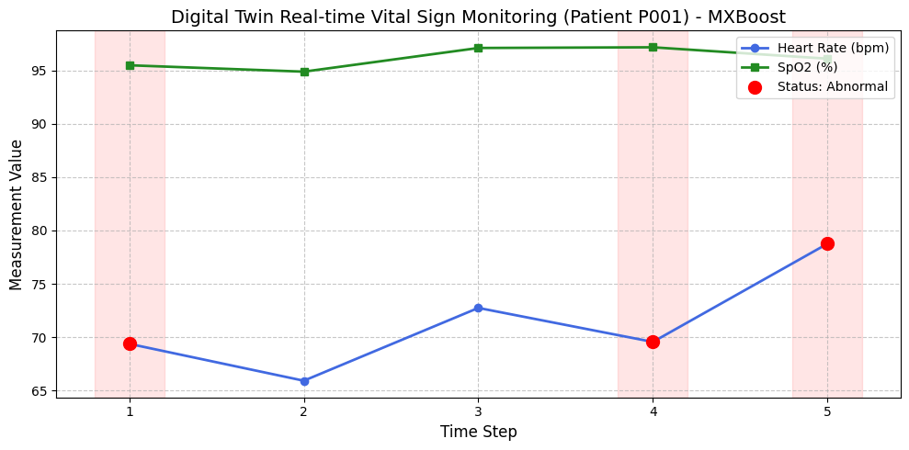
Digital Twin Simulation
Fig 12: Horizontal bar chart of feature importance from Random Forest Real-time Digital Twin simulation for Patient P001
31
Results And Discussion

Slide 33
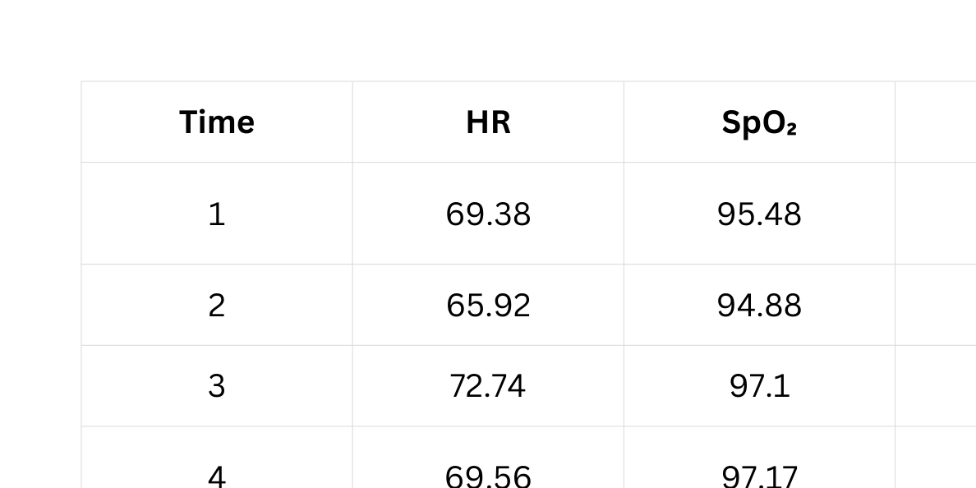
Digital Twin Simulation
Table 4.4: Digital Twin Abnormal Reading Simulation Results
32
Results And Discussion

Slide 34

Conclusion
33

Slide 35
Summary of Key Findings
The proposed federated digital twin framework successfully enables personalized healthcare monitoring.
Integration of multimodal vital sign and lifestyle data improves health risk prediction accuracy.
Federated learning ensures patient data privacy by eliminating raw data sharing.
The hybrid MXBoost model achieves high predictive performance with reliable anomaly detection.
Experimental results demonstrate the scalability and effectiveness of the proposed system for healthcare applications.
34
Conclusion

Slide 36
Contributions
✓ Framework Design: Proposed a secure and personalized federated digital twin framework for healthcare monitoring.
✓ Multimodal Integration: Integrated vital sign and lifestyle data to enable patient-centric health analysis.
✓ Privacy Preservation: Applied federated learning to ensure data privacy without sharing raw patient data.
✓ Hybrid AI Model: Developed a hybrid MXBoost model to achieve accurate health risk prediction.
✓ System Evaluation: Validated the proposed system using real patient data and standard machine learning metrics.
35
Conclusion

Slide 37
Limitations and Future Work
Limitations
✓ The system was evaluated using limited publicly available healthcare datasets.
✓ Real-time deployment with live IoT sensor streams was not fully implemented.
✓ The federated learning setup was simulated, not tested across multiple real institutions.
✓ Explainability of hybrid AI (MXBoost) decisions is still limited for clinical interpretation.
✓ Communication and computational overhead in large-scale federated environments were not extensively analyzed.
36
Conclusion

Slide 38
Limitations and Future Work
Future Work
✓ Apply the proposed framework to real-time IoT and wearable sensor data.
✓ Validate the system using large-scale clinical datasets across multiple healthcare institutions
.
✓ Integrate deep learning models such as LSTM or Transformers for temporal health analysis.
✓ Enhance model explainability using AI techniques like SHAP or LIME.
✓ Optimize federated learning for lower latency, better scalability, and stronger privacy guarantees
37
Conclusion

Slide 39
Conclusion
This thesis presents a secure and personalized digital twin–based healthcare monitoring framework using IoT and hybrid AI techniques.
The proposed system addresses key challenges such as data privacy, limited personalization, and fragmented healthcare data through federated learning and multimodal data integration.
Experimental evaluation demonstrates that the hybrid MXBoost model achieves high prediction accuracy while enabling real-time health monitoring and early anomaly detection.
Overall, the proposed framework shows strong potential for scalable and privacy-preserving healthcare applications.
38
Conclusion

Slide 40
References
[1] Liu et al., A Revolution of Personalized Healthcare: Enabling Human Digital Twin with Mobile AIGC, IEEE Internet of Things Journal, 2024.
[2] Sun et al., Digital Twins for Cyber-Physical Healthcare Systems: Challenges and Perspectives, IEEE Transactions on Industrial Informatics, 2024.
[3] Mehmood et al., A Digital Twin Framework for Real-Time Healthcare Monitoring, Journal of Intelligent & Fuzzy Systems, 2025.
[4] Shan et al., CFL-IDS: Clustered Federated Learning Framework for IIoT, IEEE Internet of Things Journal, 2024.
[5] Bhavsar et al., FL-IDS: Federated Learning-Based IDS Using Edge Devices, IEEE Access, 2024.
[6] Arafeh et al., Cluster-Based Split Federated Learning for Non-IID IoT Data, CSNet Conference, 2024.
[7] Rieke et al., The Future of Digital Health with Federated Learning, Nature Machine Intelligence, 2025.
[8] Li et al., Federated Learning: Challenges, Methods, and Applications, IEEE Signal Processing Magazine, 2024.
[9] Zhang et al., Digital Twins for Personalized Medicine, npj Digital Medicine, 2023.
[10] Kaggle, Human Vital Signs Dataset, Kaggle Datasets, 2024.
39
References

Slide 41


